Slide 1
Arm Robot
Arm robot construction (software & hardware)
By Eng./Mohamed hafez

Slide 2
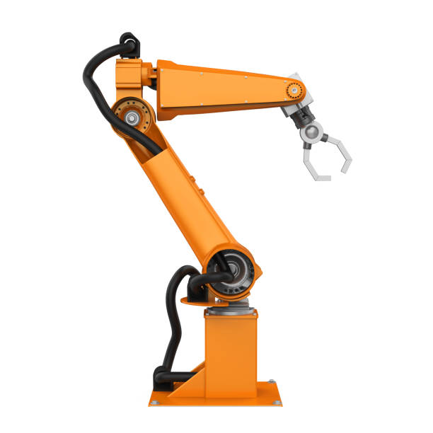
What is robot
robot, any automatically operated machine that replaces human effort, though it may not resemble human beings in appearance or perform functions in a humanlike manner. By extension, robotics is the engineering discipline dealing with the design, construction, and operation of robots. humanoid robot

Slide 3

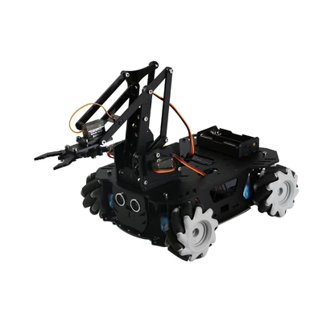
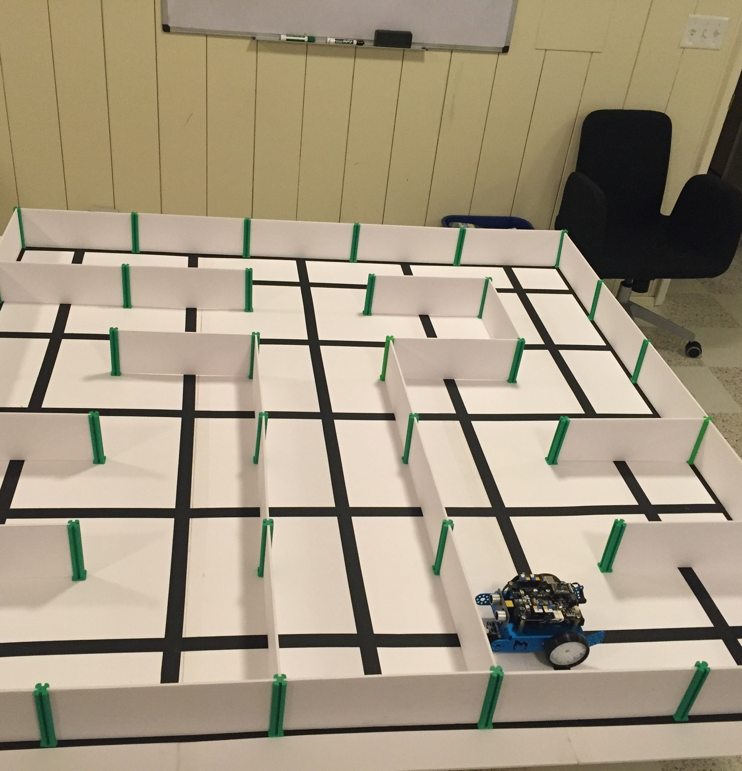
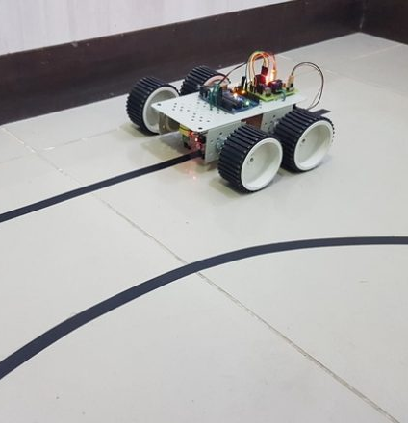
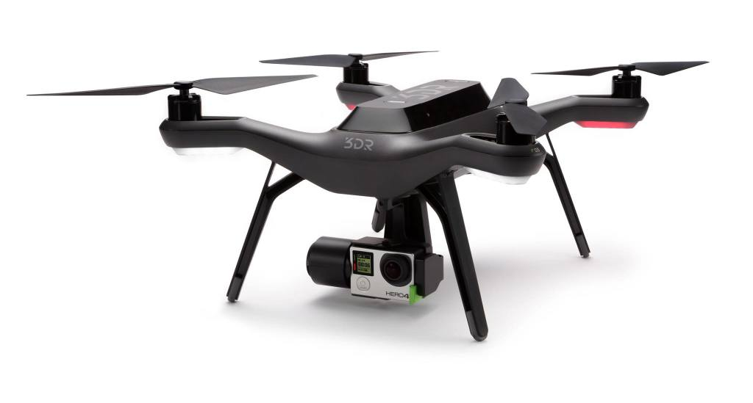
Types of robot
Arm robot.
Line follower robot.
Maze solving robot.
Drone robot.

Slide 4
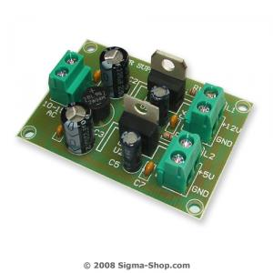
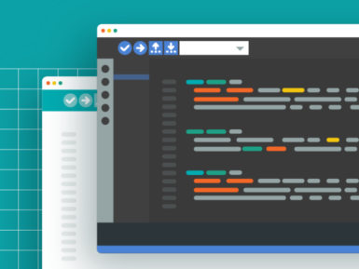
Robot component
Mechanical part.
Electronics part.
Software part.

Slide 5
Machinal part
Steps to design robot :-
What is purpose?
Design and sketch.
How many degree of freedom we need
Robot design software to calculate torque and analysis.
select suitable martial And controller
write program

Slide 6
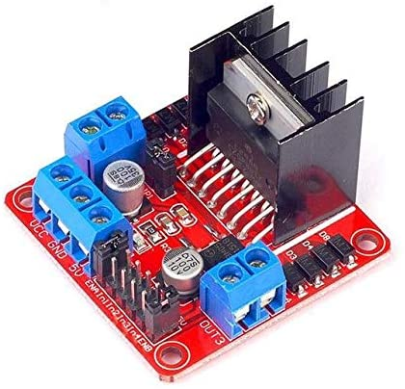
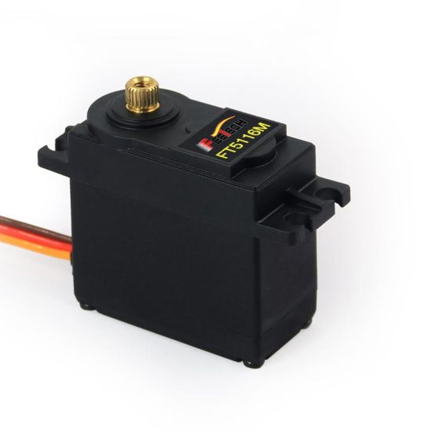
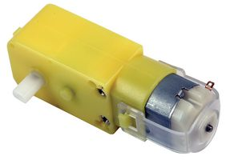
Electronics part
Power circuit +12v, +5v.
DC motor.
Driver circuit to control on direction motor.
Servo motor.

Slide 7
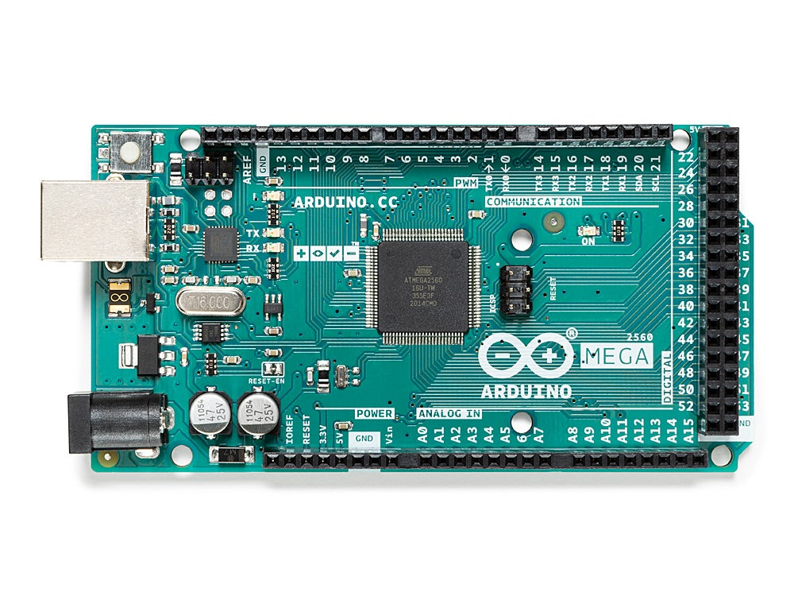
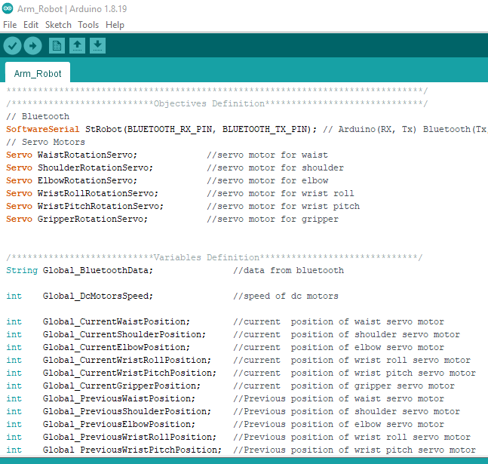
Software part

